Slide 1


17-18 mai 2019

Slide 2

PROBLEM
Price is an important concern for customer booking travel online.
Hotels leave you disconnected from the city and its culture.
No easy way exists to book a room with a local or become a host.
<number>

Slide 3
SOLUTION
Une plateforme / app / … où les utilisateurs …
Save Money when traveling
Make Money when hosting
Share Culture local connection to the city
A
B
C
<number>

Slide 4
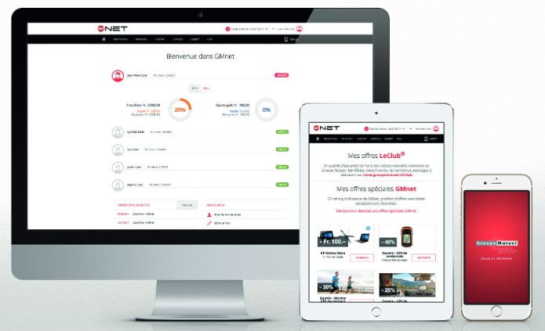
PRODUCT
SEARCH BY MEDICATION
<number>

Slide 5
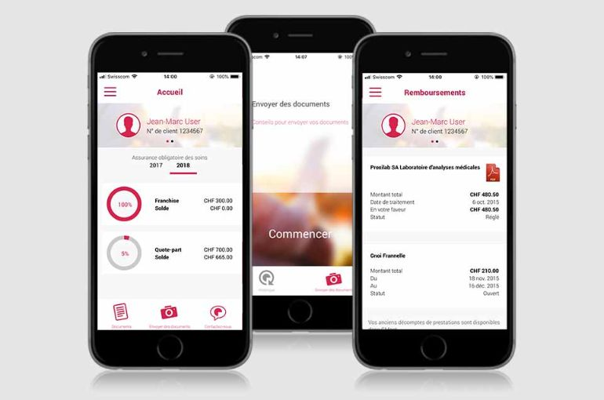
PRODUCT
SEARCH BY DOCTOR
<number>

Slide 6
MARKET SIZE
2+ Billion
Trips Booked (WorldWide)
Total Available Market
560+ Million
Budget&Online
Serviceable Available Market
84 Million
Trips w/ AirBnB
Share of Market
15% Available Market
*source: Travel Industry Assn. of America and World Tourism Organization.
**source: comScore
<number>

Slide 7
MARKET VALIDATION
couchsurfing.com
670,000 TOTAL USERS
craigslist.com
17,000 TEMPORARY HOUSING LISTINGS
In SF & and NYC from 7/09 to 7/16
<number>

Slide 8
MARKET ADOPTION
EVENTS
PARTNERSHIPS
CRAIGSLIST
Target events monthly﻿
﻿Octoberfest (6M)﻿
﻿Eurocup (3M)﻿
﻿Summerfest (1M)﻿
﻿Mardigras (800,000)﻿
﻿Cebit (700,000)
﻿Cheap/alternative travel﻿
﻿Kayak﻿
﻿Goloco﻿
﻿Orbitz﻿
﻿Dual posting feature﻿
<number>

Slide 9
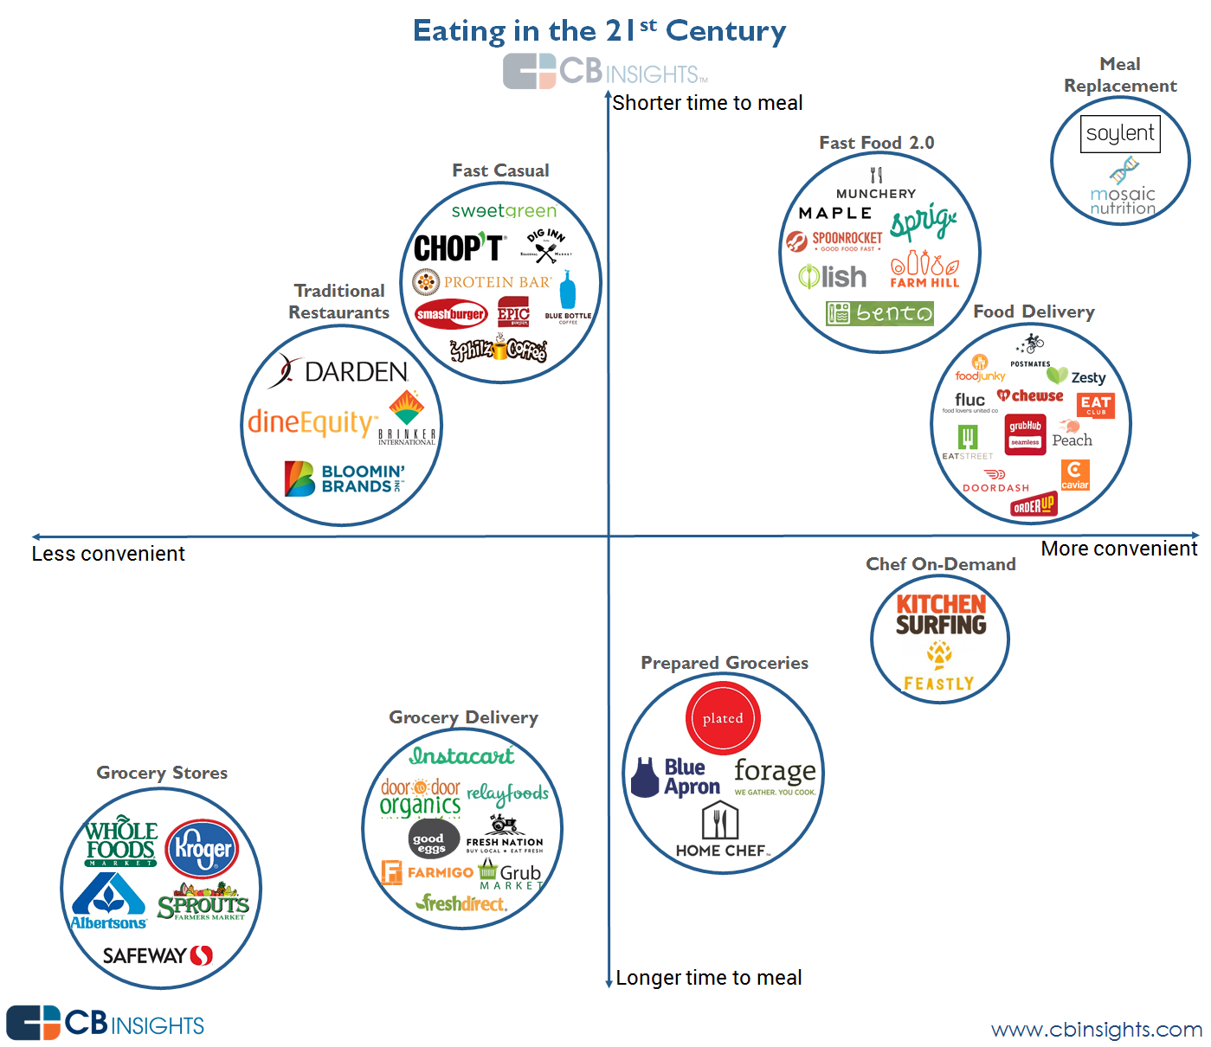
COMPETITION
<number>

Slide 10
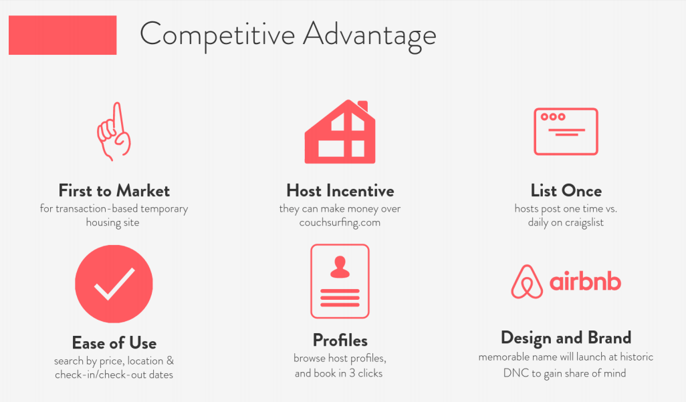
COMPETITIVE ADVANTAGE
<number>

Slide 11
BUSINESS MODEL
we take a 10% commission on each transaction
$84 MILLION DOLLARS
Trips with AirBnB
15% of Available Market
$25 AVERAGE FEE
$80/night
for 3 nights
$200 MILLION DOLLARS
Revenue projected by 2011
<number>

Slide 12

TEAM
PRENOM NOM
TITIRE
FORMATION / TRACK RECORD
PRENOM NOM
TITIRE
FORMATION / TRACK RECORD
PRENOM NOM
TITIRE
FORMATION / TRACK RECORD
PRENOM NOM
TITIRE
FORMATION / TRACK RECORD
PRENOM NOM
TITIRE
FORMATION / TRACK RECORD
<number>

Slide 13

USER TESTIMONIALS
<number>

Slide 14
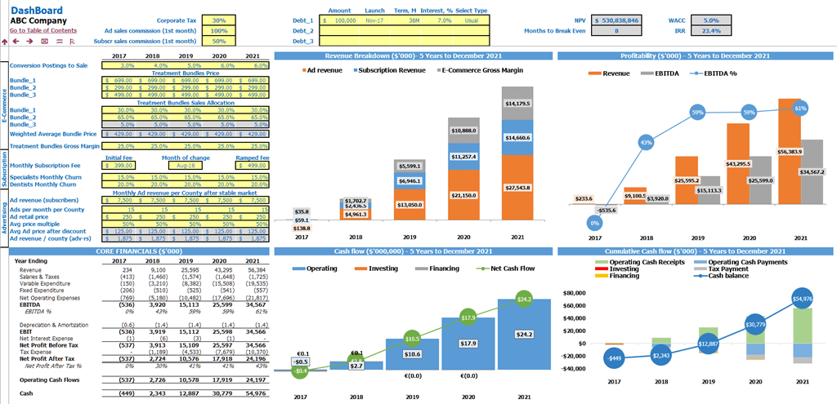
FINANCIAL
<number>

Slide 15
17-18 mai 2019

Slide 16


